Slide 1
Capstone Project
Presented By :
Batch 1 AmoFlip
Alekhya
Aravind . G
Jabeer . S
Jaswanth . S
Jothika . A
KaandhaKumar . M
Naveen . K
Naveen . B
Karthick . S
Sai Tejaswni . K
Srija

Slide 2
CONTENTS
INTRODUCTION
MODELS OF E-COMMERCE
PROCESS OF E-COMMERCE
GROWTH FACTORS
PROS AND CONS
LANGUAGES USED
OUTPUTS

Slide 3
WHAT IS E-COMMERCE
Commonly known as Electronic Marketing.
“It consists of buying an selling goods and services over an electronic systems Such as the internet and other computer networks”.
E-Commerce does not only occur on desktop, though. In fact, most E-Commerce traffic is driven through mobile commerce.

Slide 4
WHY USE
E-COMMERCE....?

Slide 5

Low Entry Cost
Reduces Transaction Costs
Access To The Global Market
Secure Market Share

Slide 6
Types Of Ecommerce Models
Business to Consumer(B2C)
Business to Business(B2B)
Consumer to Consumer(C2C)
Consumer to Business(C2B)

Slide 7
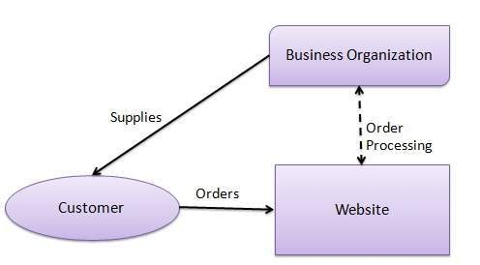
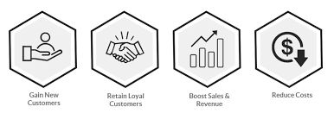
B2C E-COMMERCE
An Ecommerce Application with coupon management system is a powerful tool to attract customers and which helps to engage with customers while giving you real time data of how and when coupons are used.
Today business play on this trend by integrating their business strategies with a Coupon Management System.

Slide 8
The Process Of E-Commerce
A Consumer uses Web browser to connect to the home page of a merchant's Web site on the Internet.
The Consumer browsers the catalog of products featured on the site and selects items to purchase. The selected items are placed in the electronic equivalent of a shopping cart.
When the consumer is ready to complete the purchase of selected items, she provides a bill-to and ship-to address for purchase and delivery.

Slide 9
Contd..
When the credit card number is validated and the order is completed at the Commerce Server Site, the merchant's site displays a receipt confirming the customer's purchase.
The Commerce Server Site then forwards the order to a Processing Network for payment processing and fulfilment.

Slide 10
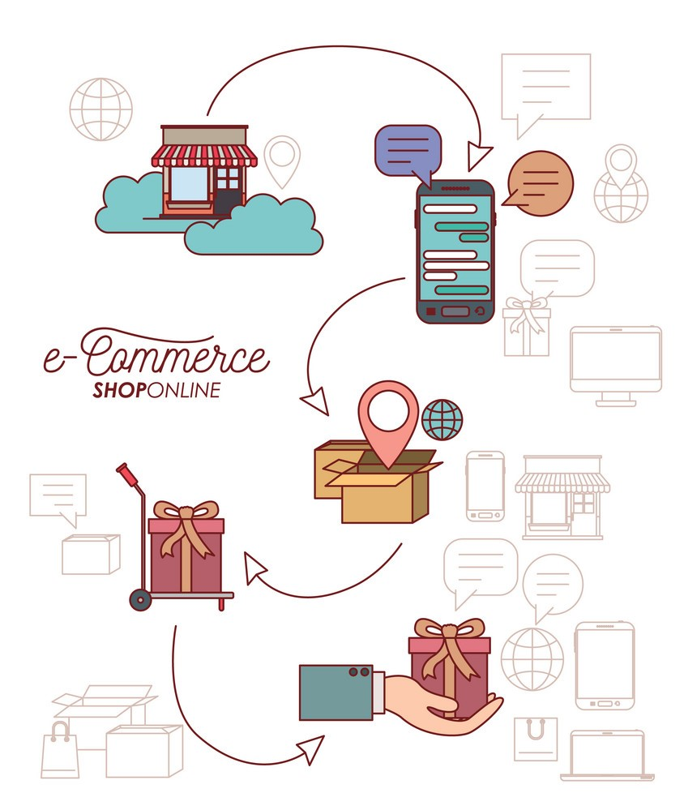
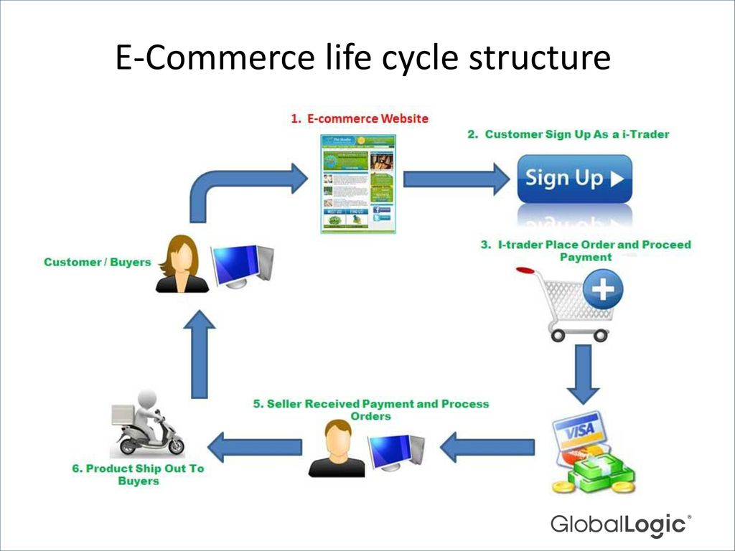

Slide 11
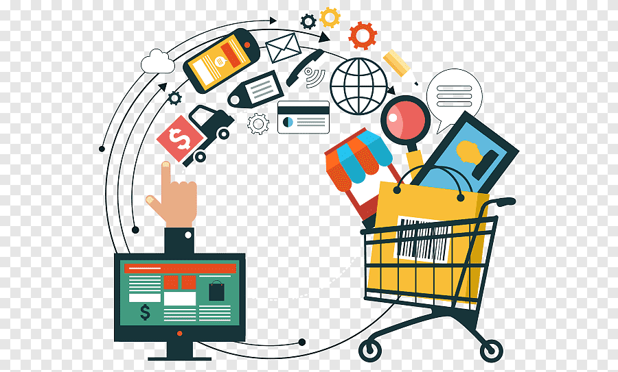
Main Growth Factors Of E-Commerce
Technology Infrastructure
Support Infrastructure
Demand Willingness

Slide 12
Benefits To Organizations
Global reach
Cost reduction
Supply chain improvements
Affordable Employees
Absence of Physical company setups

Slide 13
Benefits To Consumers
More products and services
Cheaper products and services
24/7 availability
Faster buying/selling procedure
Convenience and Easiness
Coupon and Deals

Slide 14
DISADVANTAGES
Lack of personal touch.
Possibility of credit card number theft
Shipping time can be lengthy.
No one can buy during a site crash.
Mechanical failures can cause unpredictable effects on the total process.
Not everyone is connected to the internet.

Slide 15
Languages Used
HTML
CSS
SQL
JAVA SCRIPT
BOOTSTRAP

Slide 16
GUI(Graphical User Interface)

Slide 17
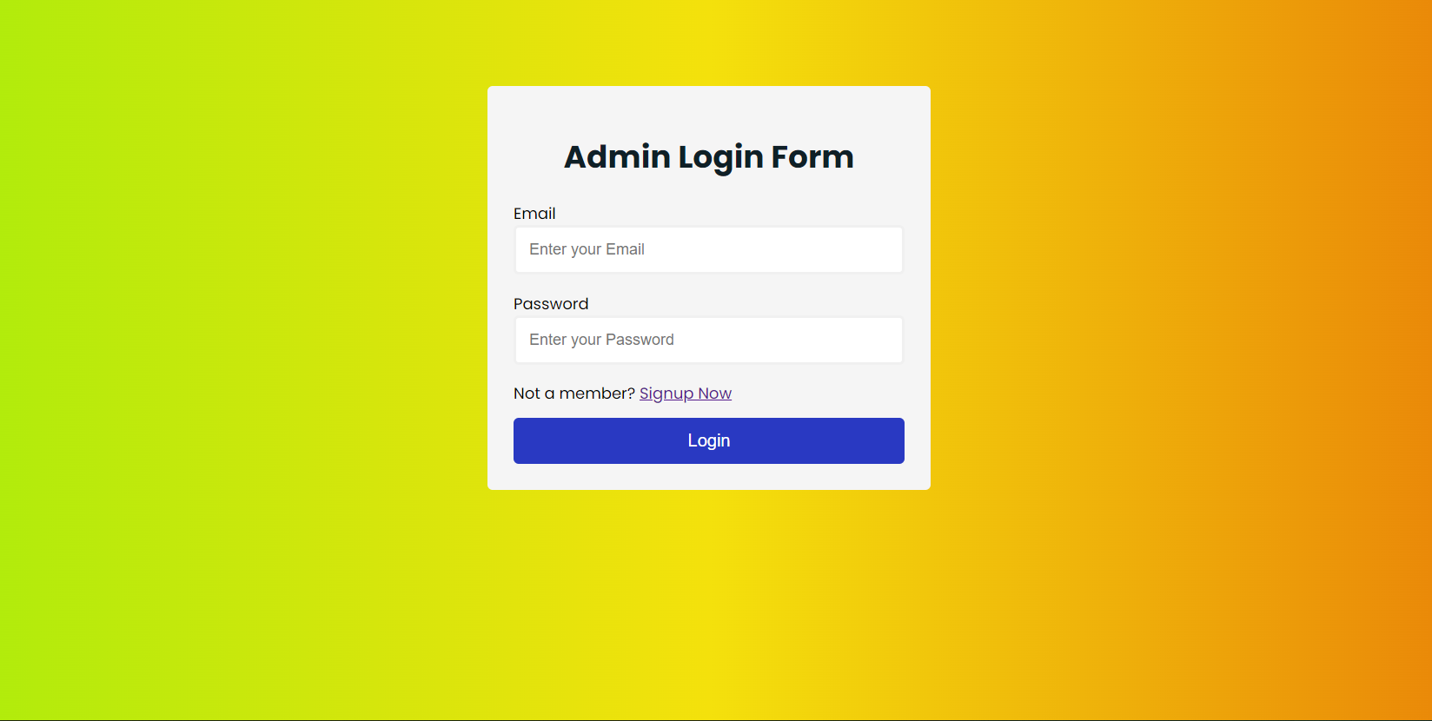
Admin LOGIN PAGE

Slide 18
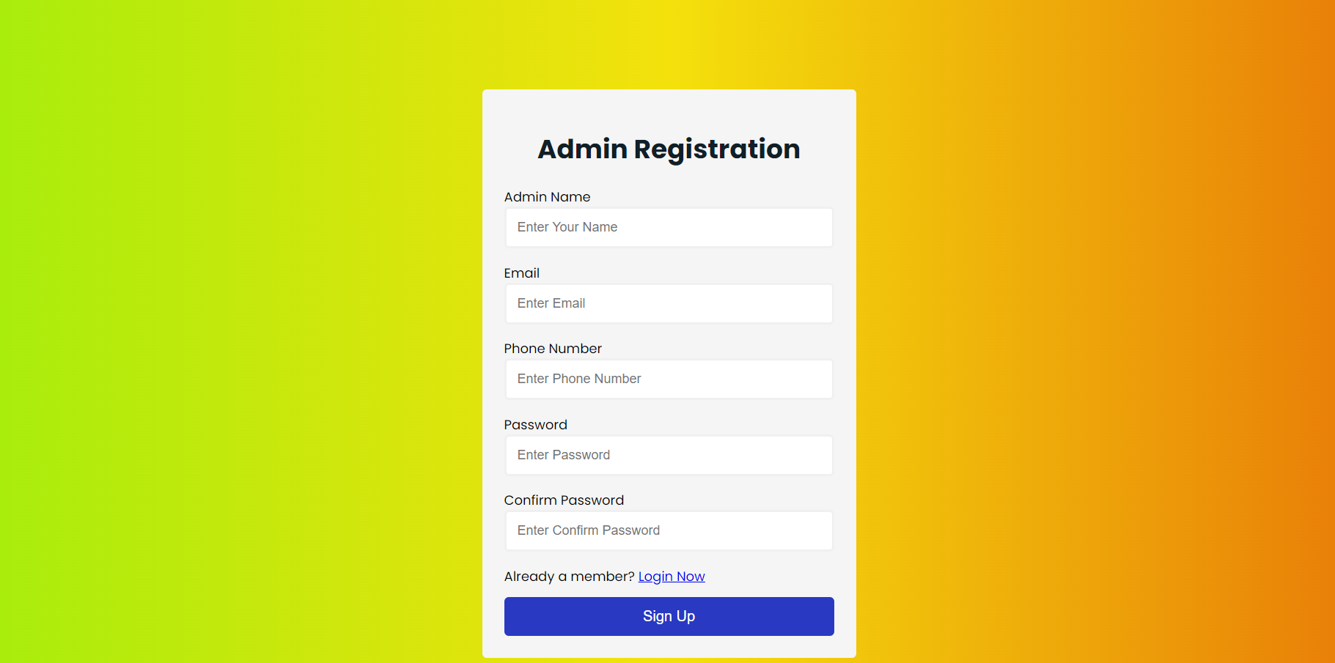
Admin Registration Form

Slide 19
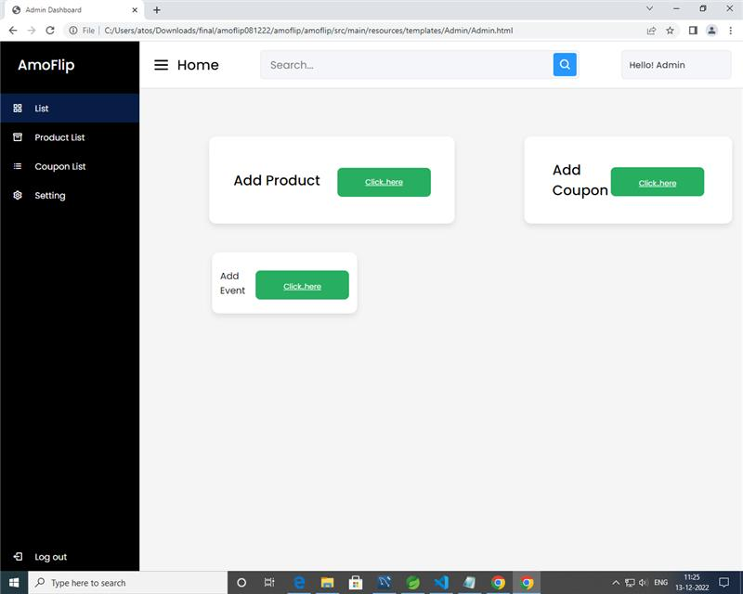
HOME PAGE

Slide 20
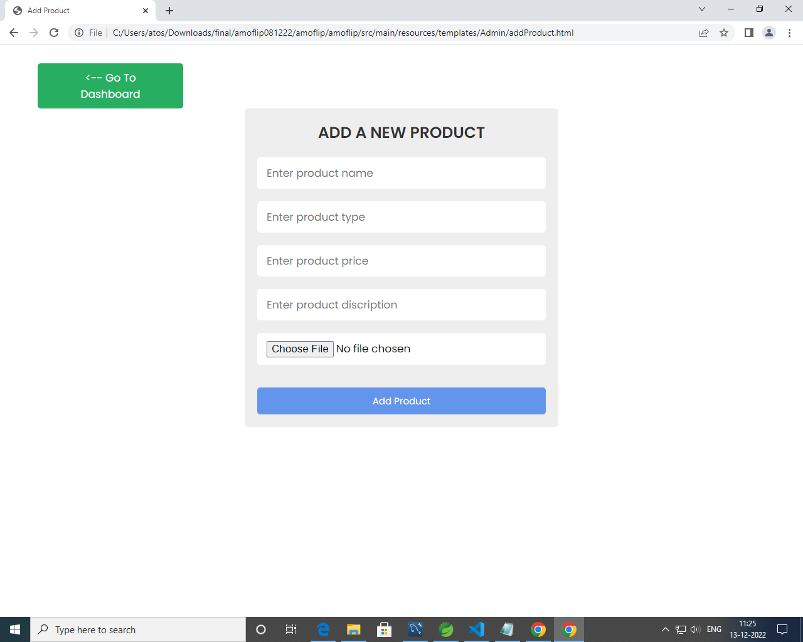
Add Products

Slide 21
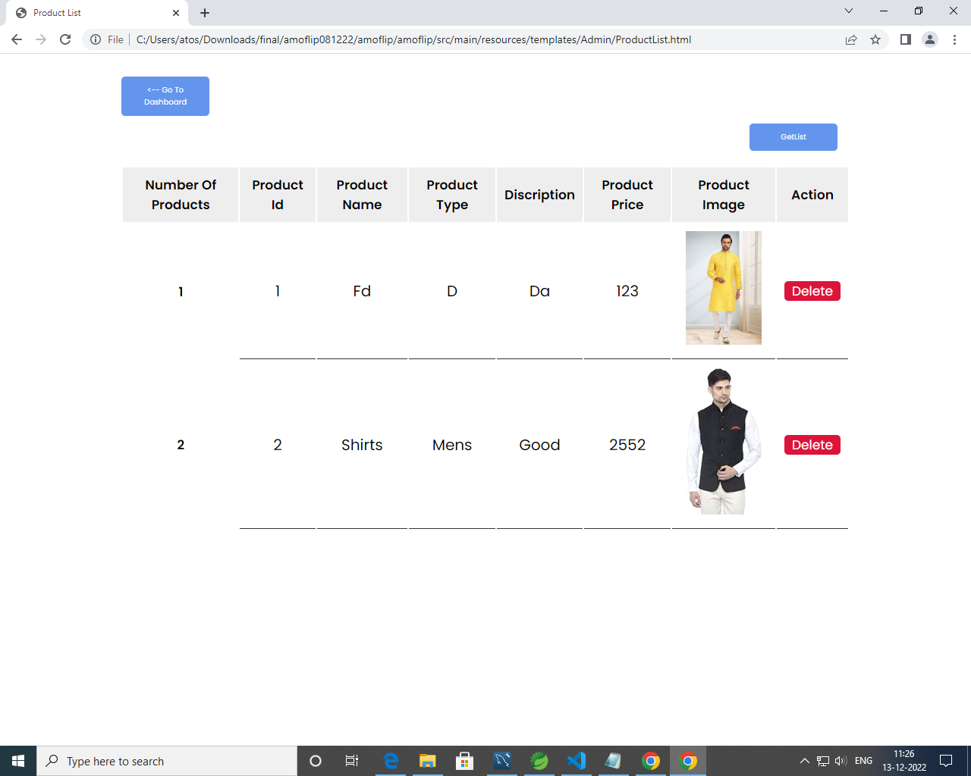

Slide 22
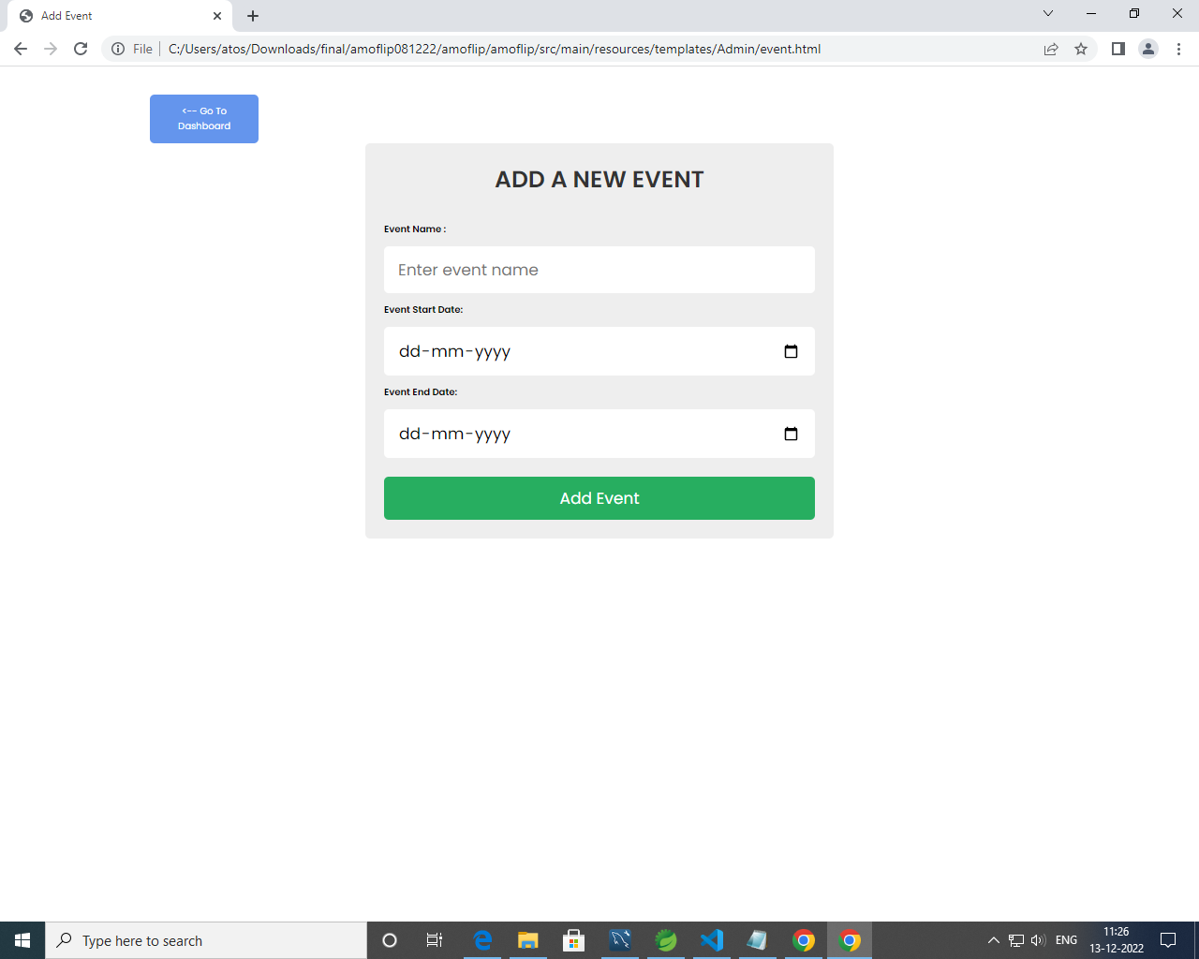
Event

Slide 23
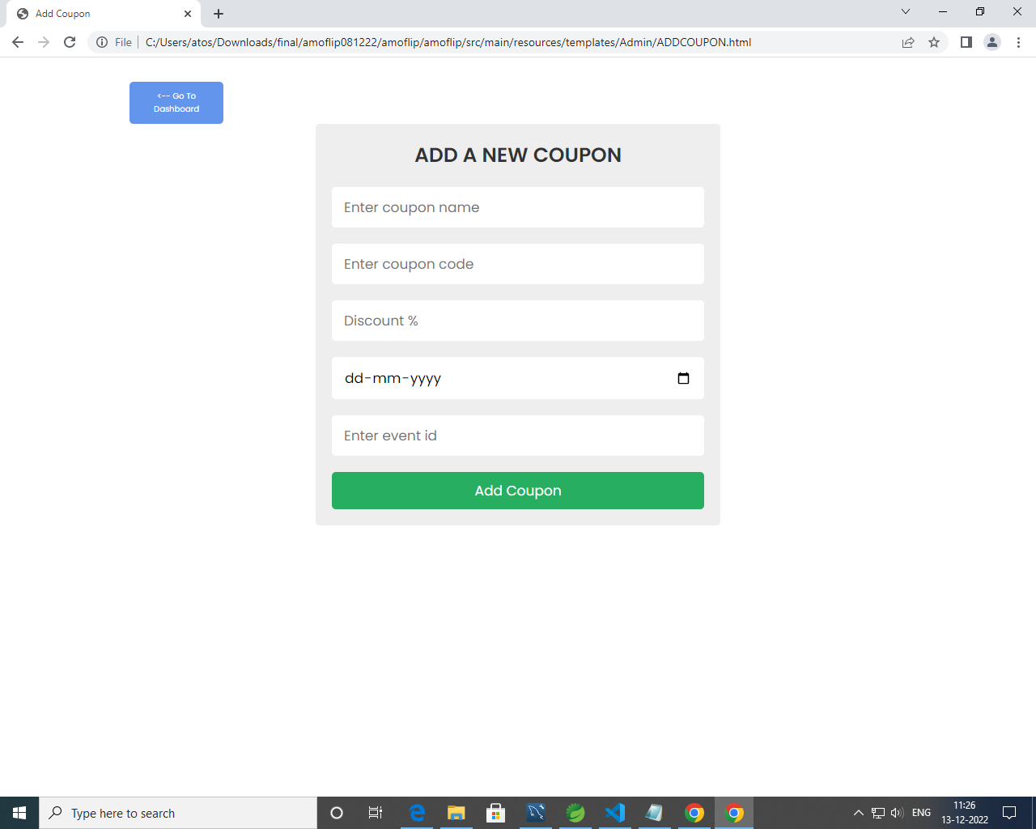
Coupon

Slide 24
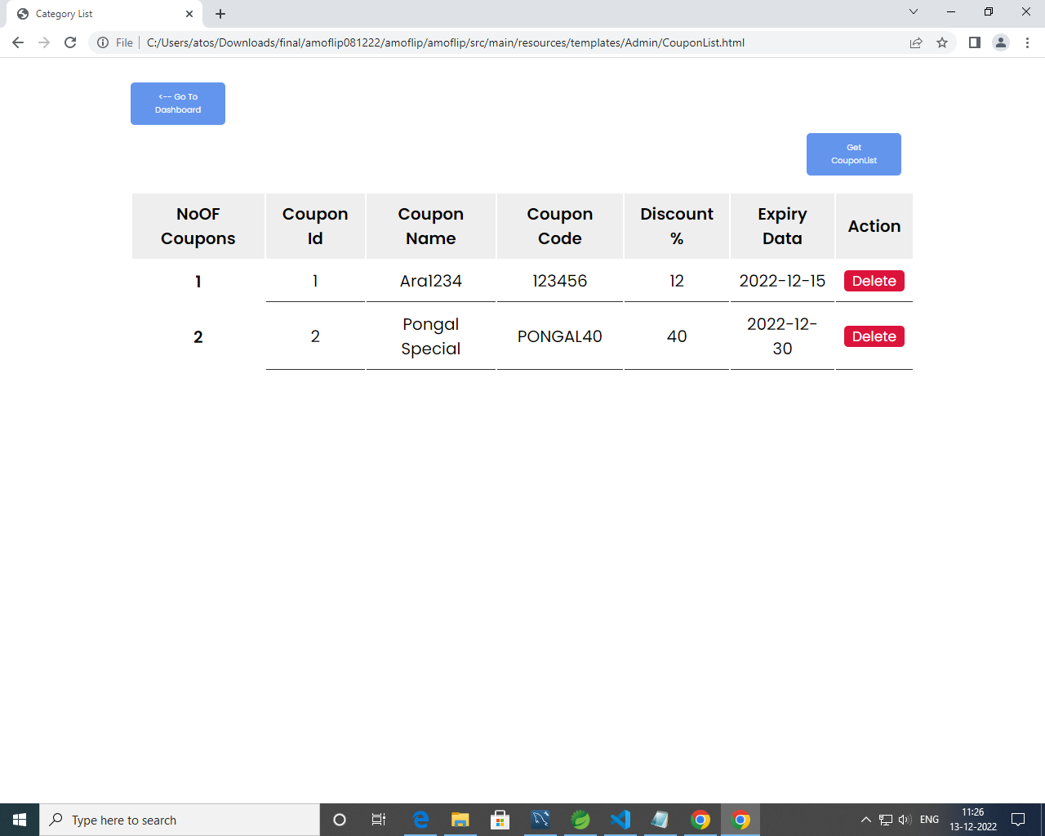

Slide 25
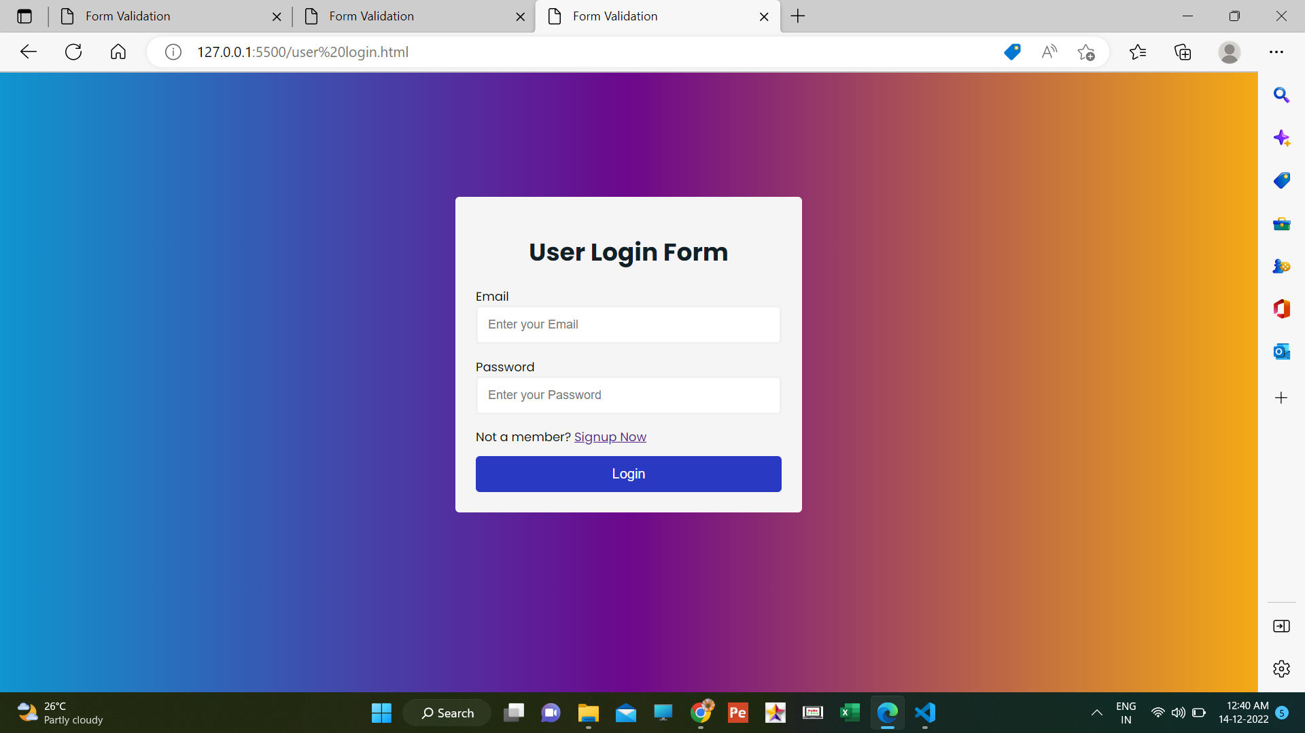
User Login

Slide 26
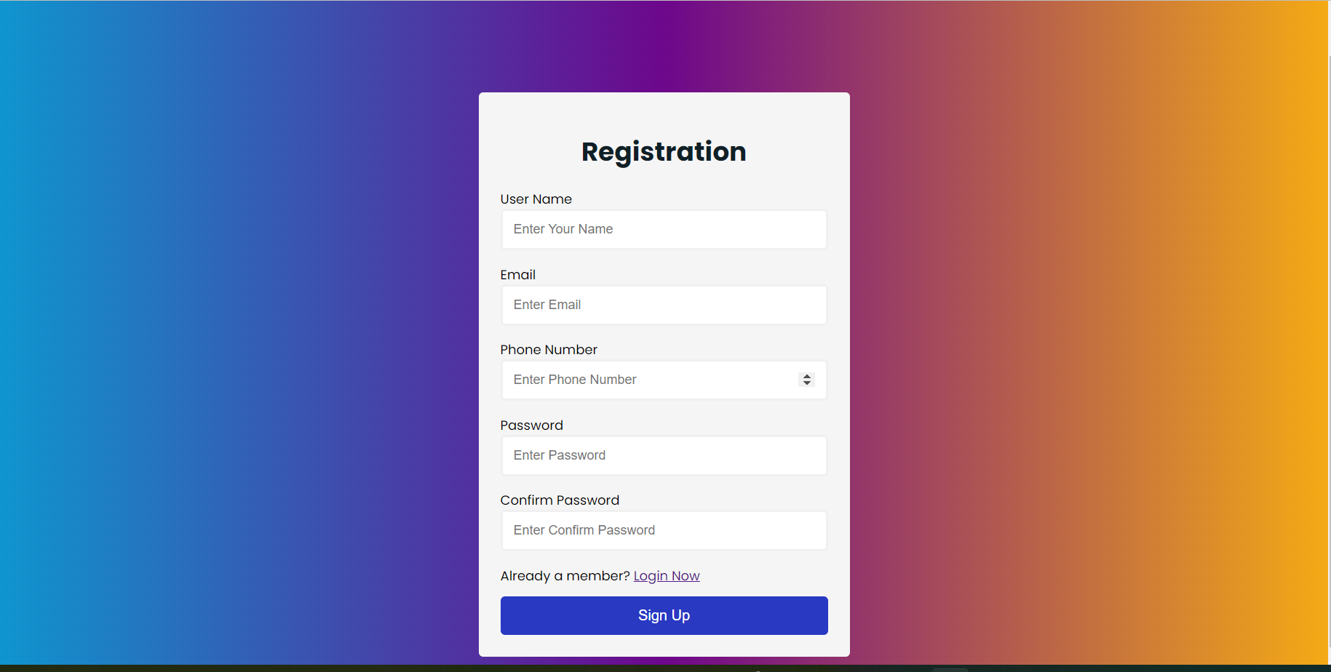
User Registration

Slide 27
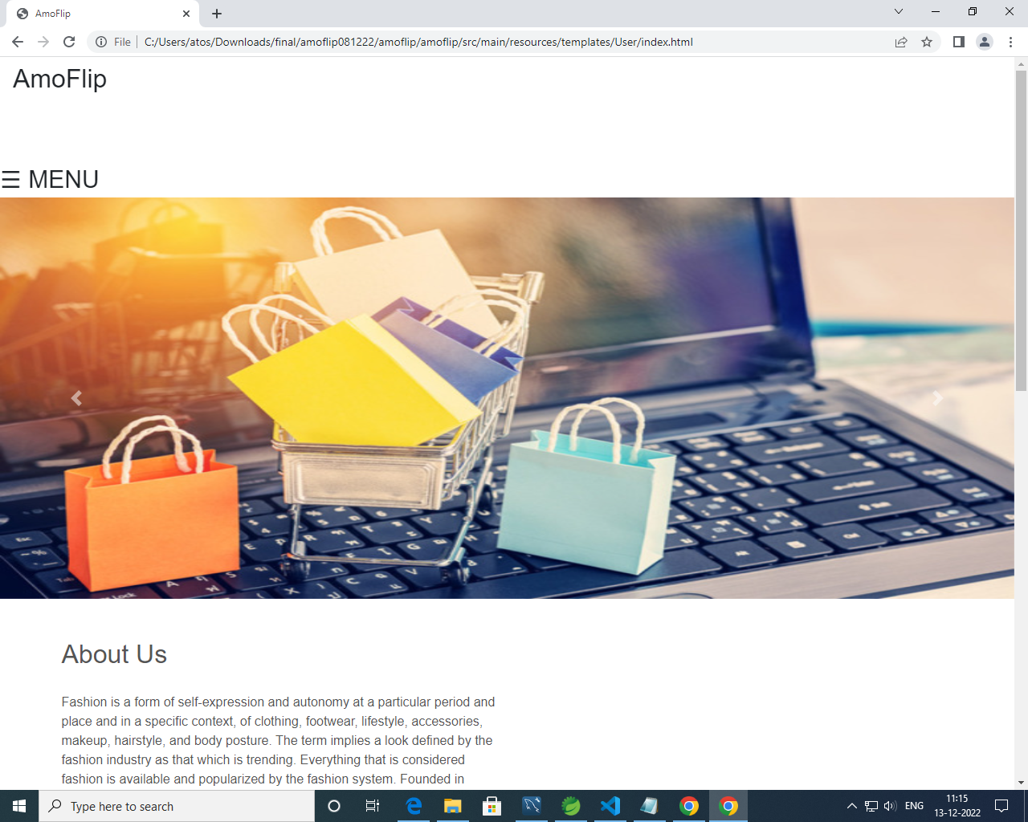
Home Page

Slide 28
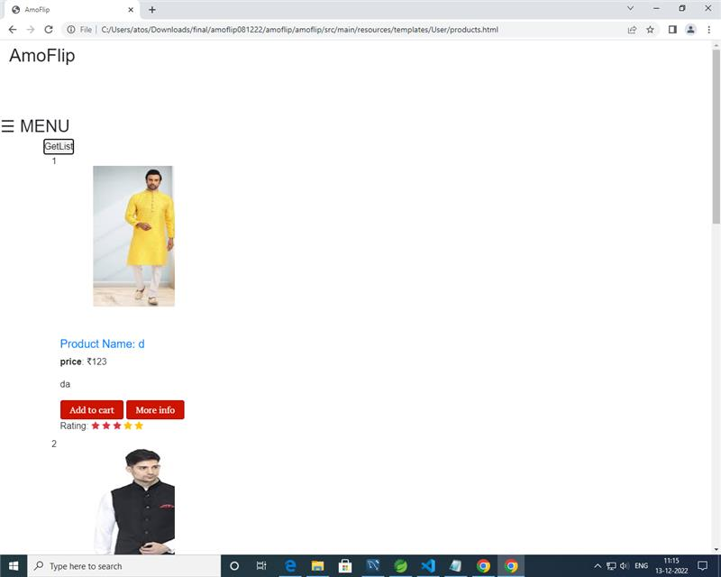

Slide 29
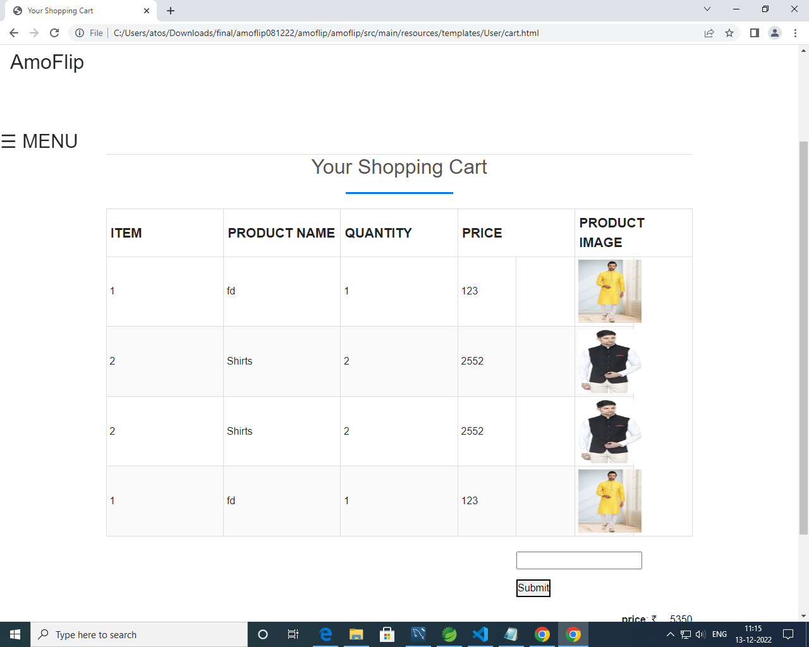
Cart

Slide 30
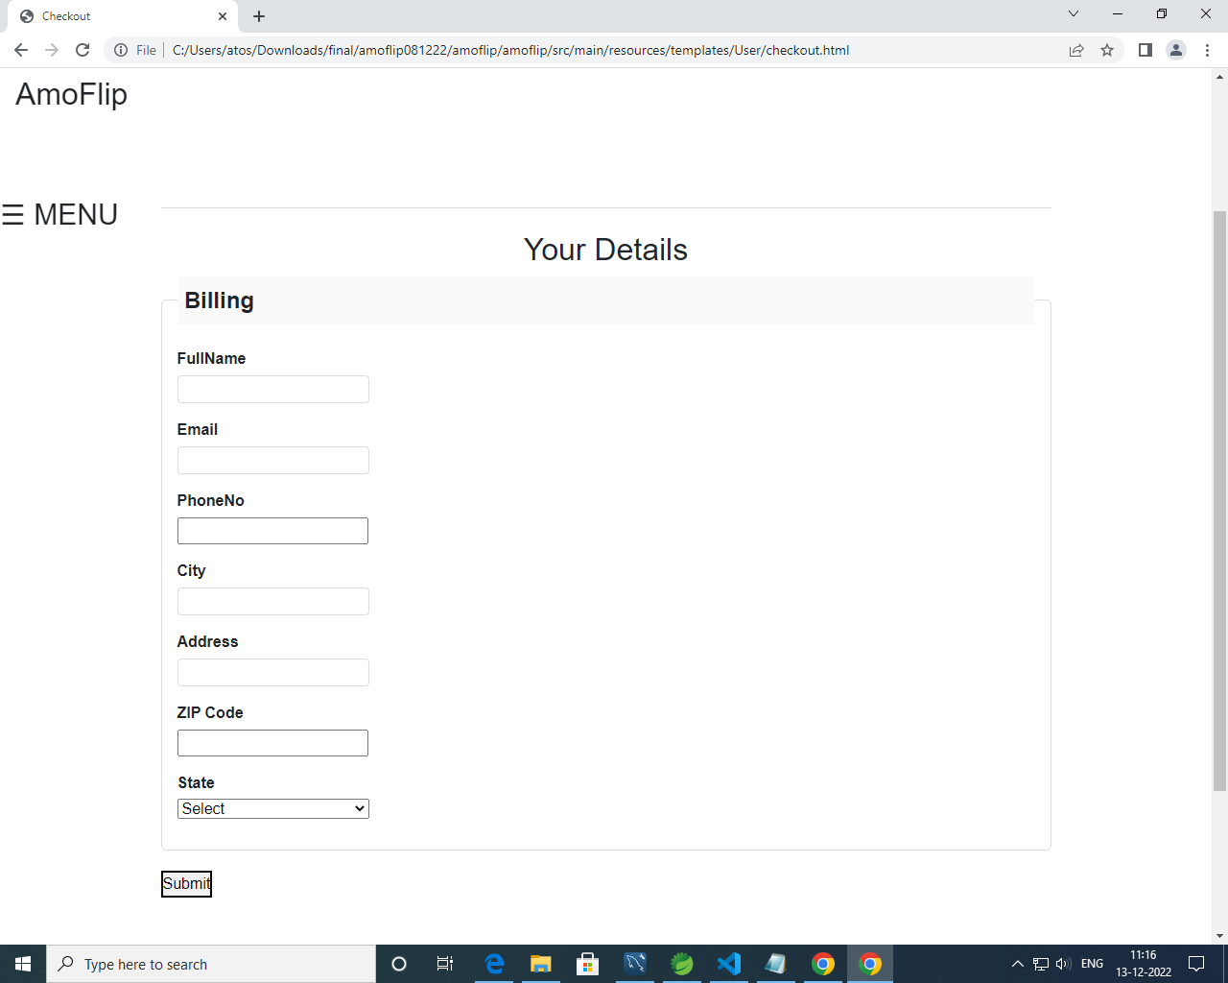
Billing

Slide 31
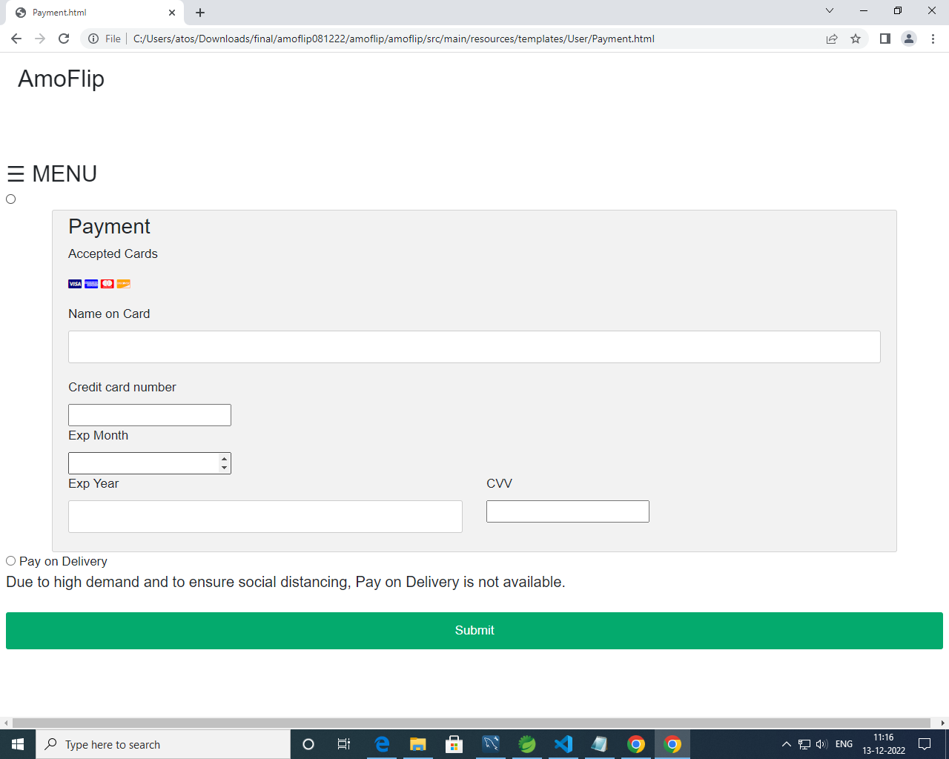
Payment

Slide 32
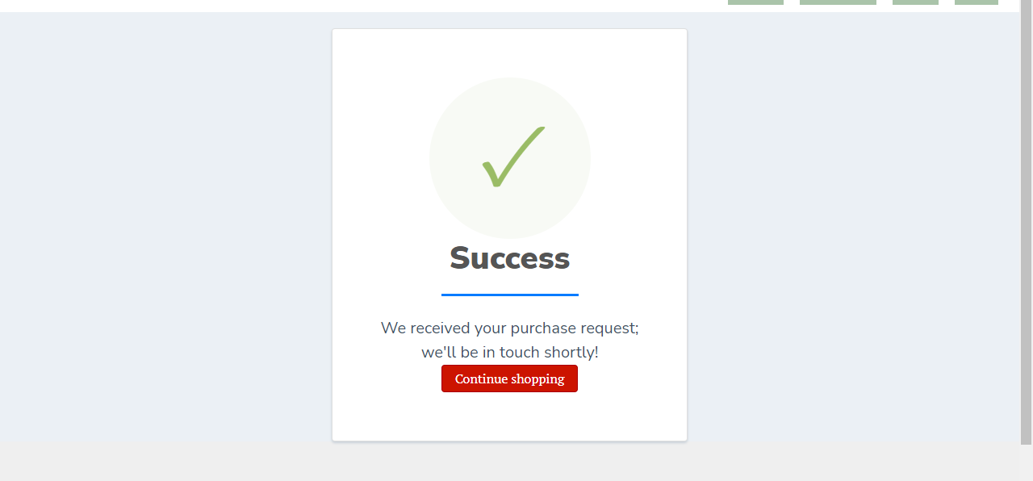
Success Page

Slide 33
THANK YOU...

